Slide 1

VisionXplorer
Smart Glasses, made for the future

Slide 2
About VisionXplorer
Our cutting-edge product is a pair of smart glasses designed to revolutionize how we perceive and interact with the world. Featuring live text translation, augmented reality, monitoring and navigation functionalities, these glasses provide users with real-time language translation, immersive digital overlays, and seamless guidance through their surroundings. With these features, our smart glasses open up new possibilities for communication, information access, and exploration, making them a must-have innovation for tech-savvy individuals.

Slide 3








VisionXplorer: Product Objectives
Enhanced Navigation
Language Barrier Breakdown
Information at a Glance
Productivity
Object Detection
Tourism & Travel
Safety
Interaction

Slide 4
VisionXplorer
“Productivity is not about being busy; it's about making every minute count”
-Someone famous

Slide 5
VisionXplorer
WHAT IF YOU DON’T USE THIS?
LESSER EFFICIENCY. Don’t believe? Let’s see an example
TASK | YOUR MOBILE | VisionExplorer
Text translation from image | Unlock device → Open Google Lens→ Take photo → Search Time taken: 10-12 seconds | JUST SEE THE TEXT Time taken: 0.5-1.25 seconds

Slide 6


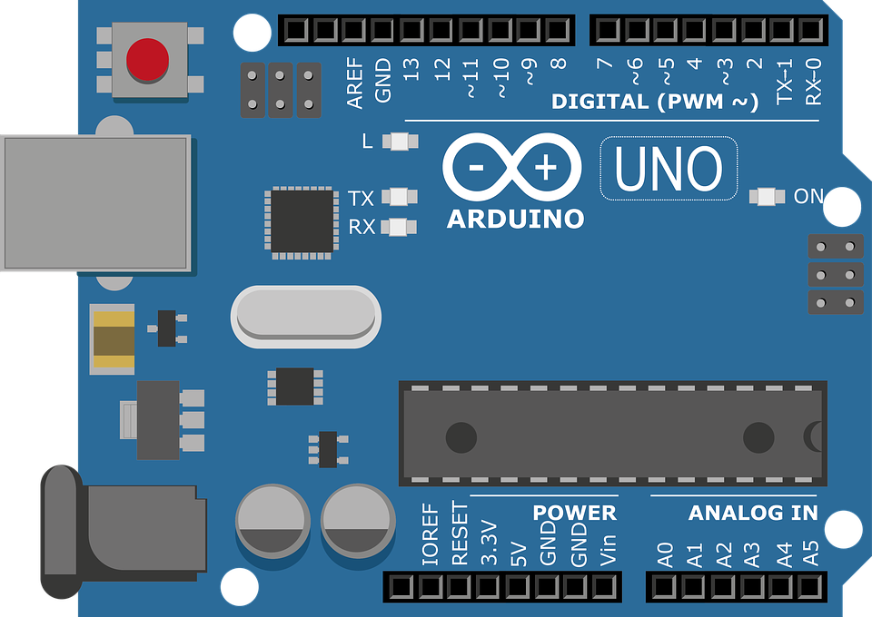

VisionXplorer
Working PRINCIPLE:
Live text translation
Information Search
Data sent to Arduino
Arduino processes the information
Computer Vision(CV), text translation API
Image input through camera module
Output on display
Data sent to Arduino
Arduino processes the information
CV, web search API, Text to speech API
Image input through camera module
Searched information being read aloud via audio module

Slide 7

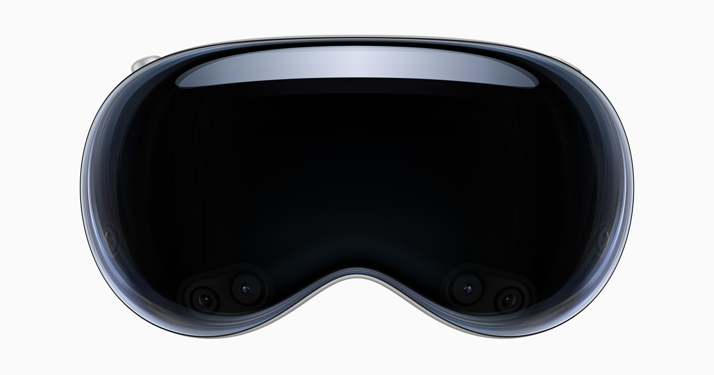
VisionXplorer
PRICE COMPARISON
APPLE VISION PRO | VisionXplorer
$3499 ≈ Rs. 2.9 Lakh
Rs. 6200

Slide 8
VisionXplorer
COST BREAKDOWN
Transparent OLED display | Rs. 1600
Frame | Rs. 100
Arduino Nano | Rs. 2900
Camera Module | Rs. 400
In/out audio module | Rs. 700
GPS module | Rs. 500
Rs. 6200

Slide 9
Future plans of VisionXplorer team
(Initial stage)
BETA
RELEASE
DEVELOPMENT CONTINUES…
Process those suggestions
Reach masses & make this a product of everyday use
Benefit the life of people
Suggestions

Slide 10

The VisionXplorer team
Garvith Murthal
The Technical head;
Coding head;
Pritish Dash
Funder;
Mechanical head;
Labeeb Ahmed
Designer
Soumyajit Dass
Project Manager
UI developer

Slide 11
THANKS!

